Slide 1
Stata Merging Guide
Nathan Favero
Texas A&M University
October 19, 2012
(2024 note: this was made with Stata 12 but still applies to newer versions)

Slide 2
Contents
Best Practices, pg. 3
Using Merge & Append, pg. 4
Merge, pg. 11
Append, pg. 14
Other Useful Commands, pg. 15
Importing Data into Stata, pg. 20
Delimited Files: Importing Variable Names, pg. 20
Importing from Microsoft Access, Pg. 21

Slide 3
Best Practices
Backup everything
Save a separate copy of the original files somewhere before you start modifying/merging
Always use a do-file to make changes
This makes it much, much easier to come back later and fix mistakes or update data
Never merge by school/district name (use IDs)

Slide 4
Merge or Append?
Merge | Append
Adding more variables | Adding more observations (individuals and/or years)
The same observations can be found in both files. | The same variables can be found in both files

Slide 5
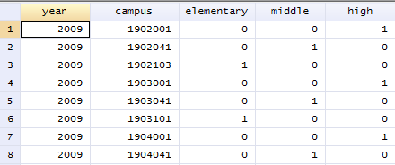
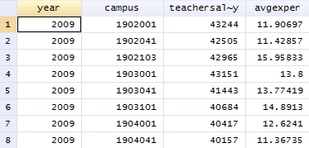
Merge
Adding Variables

Slide 6
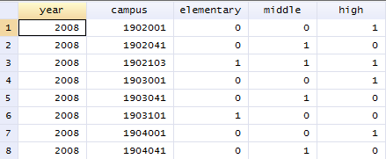
Append
Adding Observations (Years)

Slide 7
Mixing Merge & Append
You can only bind 1 direction (horizontally or vertically) at once.
If you’re combining both directions, you have to plan the order in which you perform your steps so that you never have to bind in 2 directions at once.

Slide 8
Mixing Merge & Append
For example, this won’t work.

Slide 9
Mixing Merge & Append
This will work.

Slide 10
Mixing Merge & Append
Or this will work.

Slide 11
Using Merge
merge [n]:[n] [varlist] using [filename]
merge 1:1
Try using this if you’re unsure.
Merging two data files with the same unit of observation
Note: If using panel data, varlist must uniquely identify both individual and year
merge m:m
Rarely used

Slide 12
Using Merge
merge [n]:[n] [varlist] using [filename]
merge m:1 or 1:m
Merging smaller unit of analysis (e.g., school) with larger unit of analysis (e.g., district)
Merging panel data (school-year) with cross-sectional (school) or time-series data (year)
m corresponds to the more specific data; 1 corresponds to the more general data (if you get this switched, you’ll simply get an error)
The [varlist] should uniquely identify the more general data (e.g, district, cross-section, or time-series)

Slide 13
Troubleshooting with Merge
Does my variable list uniquely identify my observations? (Remember, you must specify both ID and Year variables in 1:1 for panel data.)
Have I correctly specified 1:1, 1:m, or m:1?
Should I be using append?
Do I already have a variable named “_merge”?
Are both files saved as “.dta”?
Are the variable names exactly the same in both files?
Are some of my variables strings in one file and numeric in the other?

Slide 14
Using Append
append using [filename]
append is a much simpler command than merge
Just make sure that:
The variable names are exactly the same in both files.
The variable types (string or numeric) are the same in both files.
Both files are saved as Stata files (“.dta”)

Slide 15
Other Useful Commands
destring [varlist], [replace or gen([var name])] ignore([characters to ignore])
Convert a string variable to a numeric variable
tab [var name] if regexm([var name], "[^0-9 .]")
Show all of the values of a variable that are non-numeric

Slide 16
Other Useful Commands
tostring [varlist], [replace or gen([var name])] [force]
Convert a numeric variable to a string variable
gen [new var name] = string([numeric var name], "%12.0f")
Use this command instead of “tostring” if you have trouble with Stata giving you scientific notation

Slide 17
Other Useful Commands
gen [new var name] = substr([string var name],[starting position],[number of characters])
Create a new variable with a fixed number of characters from another string variable (e.g., first 3 characters)
order [varlist], after([var name])
order [varlist], first
Change the order in which your variables appear

Slide 18
Other Useful Commands
duplicates report [varlist]
Learn about the number of duplicates
duplicates drop
Drop any exact duplicates
duplicates tag [varlist], gen([var name])
Create a variable that tags duplicate observations

Slide 19
Other Useful Commands
foreach var of varlist [varlist] {
rename `var' [prefix]_`var'
}
Adds a prefix to the beginning of each variable name
reshape wide [vars that contain varying data], i([identifying var(s)]) j([var that distinguishes observations that have the same identifying var(s)])
Consolidates multiple observations into a single observation by adding variables

